Slide 1
Lecture 30
Waveguide coupling
Integrated Electro-optic modulators

Slide 2
Waveguide mode coupling
Consider two propagating modes in the waveguide
n₃
n₁
n₂
subtract
Now consider that dielectric permittivity is perturbed as , integrate over the area of waveguide and use orthogonality

Slide 3
Waveguide mode coupling
Introduce
Introduce and drop primes.
Normalization:
TE wave
TM wave
So, for coupling of two TE waves
So, for coupling of two TM waves
For the well confined waveguides or when indices in core and cladding are close..

Slide 4
Coupling between two waveguides
Two modes solutions of
subtract
Integrate over dxdy

Slide 5
Coupling between two waveguides
The modes are not orthogonal
Finally, after adjusting effective indices and dropping primes

Slide 6
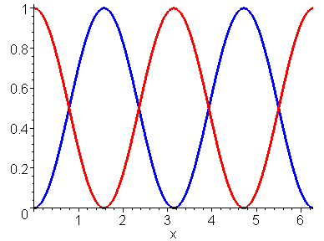

Directional coupler
Assume
Boundary conditions
L
or
L_{b}
P₂
P₁
Beat length
3dB coupler
L=L_{b}/4
κz
L

Slide 7
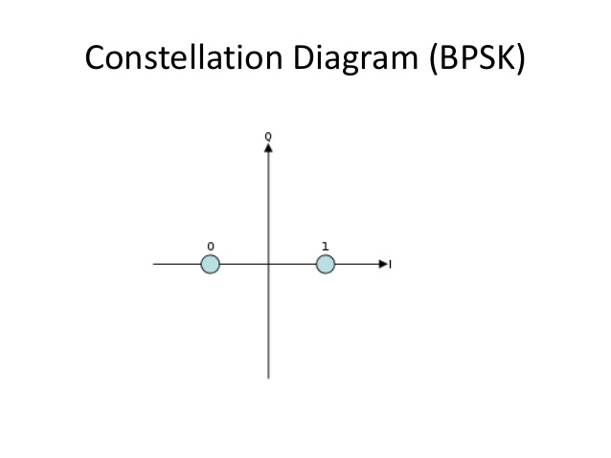
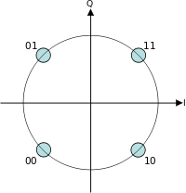
Heterodyning and Coherent communications
In coherent optical communications one needs to detect phase of the signal
To detect phase one combines usually weak signal with a strong signal of local oscillator
(a.k.a. heterodyne or homodyne) whose phase is constant.
signal
QPSK
amplifier
LO
Optical power is
Photodetector current
Responsivity (A/W)
Measuring relative phase
The signal gets amplified when combined with LO , but still current due to LO is much stronger than current due to the amplified signal it can saturate the amplifiers and also its relative intensity noise (RIN) deteriorates signal to noise ratio

Slide 8
Optical hybrid
signal
1
+
-
amplifier
LO
2
Balanced detector
Optical field in the upper arm
Optical field in the lower arm
Optical power on detector 1
Optical power on detector 2
If the detectors have identical responsivities (balanced detector) subtracting the two currents cancels all currents except the signal current All the RIN gets cancelled.

Slide 9
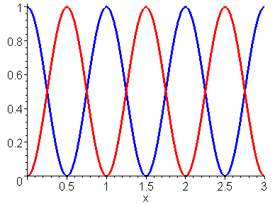
Mach Zehnder Interferometer
ΔL
A_{1,in}
A_{1,out}
A_{2,in}
A_{2,out}
Assume A_{1,in}=A₀ and A_{2,in}=0.
Free Spectral range
P_{2,out}
Can be used as a sensor, or a frequency discriminator
P_{out}/P_{in}
P_{out}(t)
P_{1,out}
t
f/FSR
0
0.5
1
f/FSR
f(t)
t

Slide 10
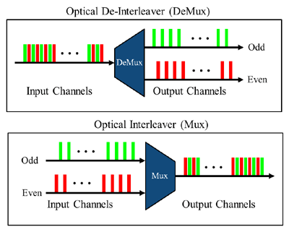
Optical Interleaver
WDM Channel separation - Δf
ΔL
4ΔL
2ΔL
FSR₁ =2Δf
FSR₂ =4Δf
FSR₃ =8Δf

Slide 11
MZI Modulator
V(t)
P₀
P₁
P₂
V(t)
Pockels Effect
“push-pull configuration”

Slide 12
Mismatched coupler
Drop the primes
L
Characteristic equation
Boundary
conditions
Solution
Beat length
P₁
P₂

Slide 13
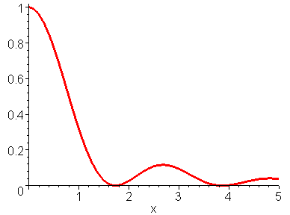
Electro-optic modulator based on directional coupler
V(t)
P₂
P₀
P₁
V(t)
P₂
V/V_{π}

Slide 14
Another look- new coupled modes (supermodes)
β₋
β₁
β₂
β₊
New modes
Symmetric
Anti-symmetric
The amplitudes of these coupled modes do not change, hence they must be the (EXACT) solutions of the wave equation.
Let us see then – we shall look for a solution to the coupled waveguide problem
C’s are constant and unknown and β is also unknown.

Slide 15
Supermode approach
β₊
Two modes
β₁
β₂
β₋
Subtract
Integrate over dxdy –use orthogonality
And so
Characteristic equation
First mode (TE00)
Solution
Second mode (TE02)

Slide 16
Adiabatic coupling
First mode (TE00)
Second mode (TE01)
Introduce
Adiabatic coupling: as coupling increases to the point where ,
β₁
β₊
β₊
β₊
β₂
β₋
β₋
β₋
As long as coupling is adiabatic (very slow changing κ, hence small angle), the modes remain separated and the mode with larger propagation constant β₁ eventually becomes symmetric mode β₊ while β₂ becomes β₋ It also works in reverse –one can separate symmetric and anti-symmetric modes

Slide 17
Symmetric adiabatic 3dB Y-coupler
β₊
β₊
β₊
1
2
β
β₋
β₋
radiation
Only ½ of input power can be coupled into a single mode waveguide – conserved brightness
β₊
β₊
β₊
β
1
2
β₋
β₋
Note 180 degrees change of phase for
radiation

Slide 18
Symmetric adiabatic 3dB Y-coupler
P_{in}
β₊
β₊
β₊
β
P_{out}
P_{in}
β
Two equal inputs are in phase:
P_{in}
β
P_{out}=0
P_{in}
β₋
β₋
Two equal inputs are 180 degrees out of phase:
radiation

Slide 19
Back to electro-optic modulator
V(t)
A_{in}
A_{out}
V_{DC}
V(t)
Bias voltage
“biased into null point”
Digital OOK(“on-off-keying”) format
Digital BPSK (“Binary Phase shift keying”)
modulation
P_{out}/P_{in}
P_{out}(t)
A_{out}/A_{in}
A_{out}(t)
1
Φ0
V/V_{π}
-0.5
t
0
0.5
t
0
0.5
1
V/V_{π}
1
V(t)
V(t)
Φ=-π
0
0
1
0
t
1
t

Slide 20
Electro-optic modulator
A_{out}/A_{in}
A_{out}(t)
V/V_{π}
t
“biased into null point”
0
0.5
1
Analog Amplitude modulation
V(t)
1
t
P_{out}(t)
P_{out}/P_{in}
“biased into quadrature point”
t
0
0.5
1
V/V_{π}
Analog Intensity modulation
V(t)
t

Slide 21
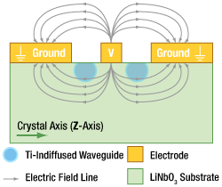
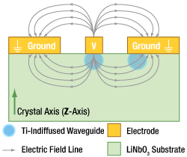
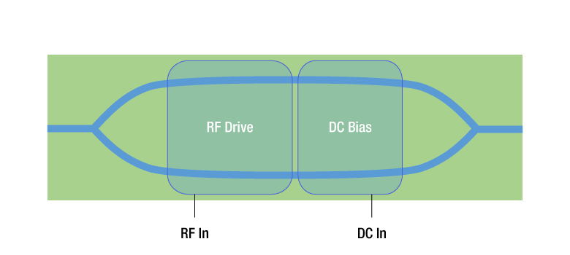
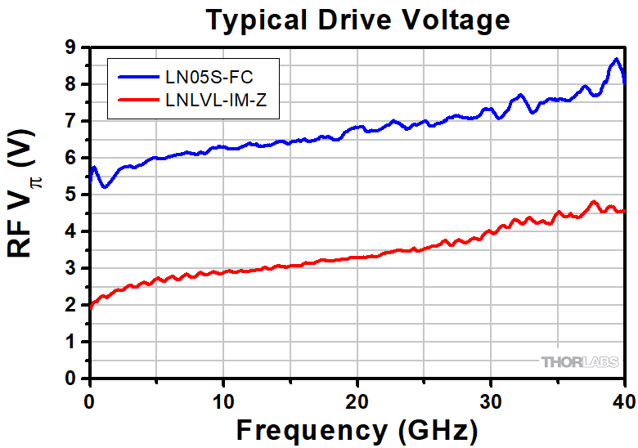
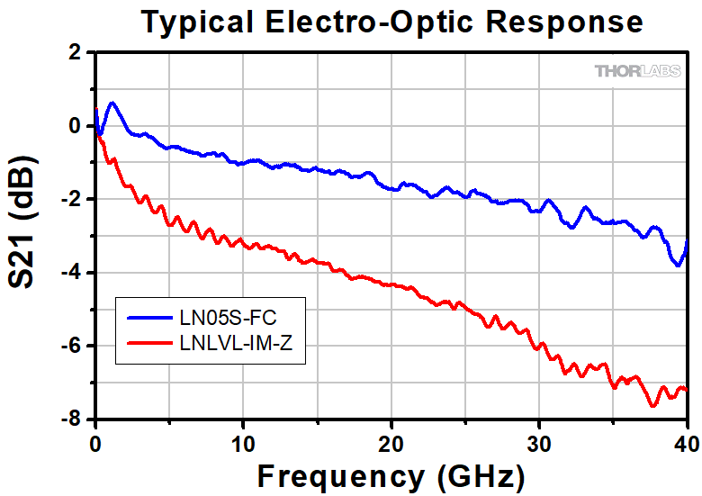
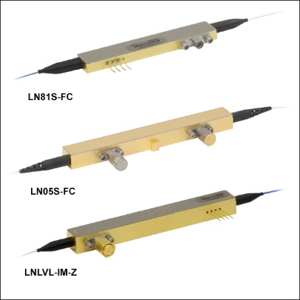
LiNbO₃ modulators
Z-Cut LiNbO₃ Intensity Modulator Cross-Section
X-Cut LiNbO₃ Intensity Modulator Cross-Section
Intensity modulators

Slide 22
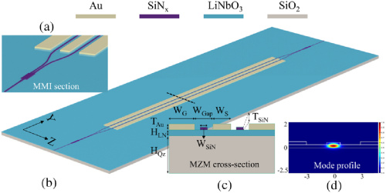
Thin film LiNbO₃ on Si Modulators
SiN platform
SOI platform

